Slide 1
DISINFECTANTS IN THE HEALTHCARE ARENA
WHAT IS TO WHAT SHOULD BE……
BY
Helene Paxton, MS, MT(ASCP),PHD, CIC
and

Slide 2
CHOICES
“The choice of a disinfectant is a difficult one. The product needs to fit the environment and assure complete disinfection. It has to be compatible with other agents in use, be safe and odor free. It has to protect and disinfect surfaces such as keyboards and monitors and other equipment with no damage. It also has to have rapid turn-around time. "

Slide 3
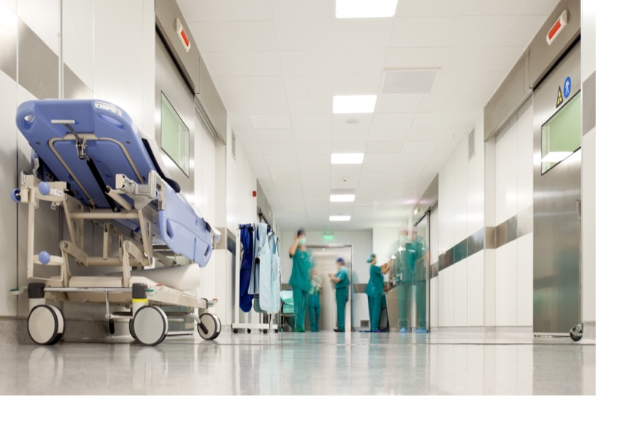
Financial Incentives of Disinfection
According to the Centers for Disease Control and Prevention (CDC), Patients that must spend extra time in a hospital due to a contracted HAI are there for an average of eight days and can cost as much as $26,000.00.
Hospitals that score in the bottom 25% for preventable harm will lose 1% of their own incoming Medicare payments.*
http://www.modernhealthcare.com/article/20141218/NEWS/312189995

Slide 4
marketing@tomimist.com
Infection Metrics Tied to Medicare Payments
Each year, some 722,000 hospitalized patients will acquire a serious infection as a result of their care.
A staggering 75,000 of them will die during their hospitalization due to the HAI.
http://www.cdc.gov/HAI/surveillance/

Slide 5
Why is Effective Disinfection Needed?
In February, the Centers for Medicare and Medicaid Services said 758 hospitals failed to reach federal targets for HAI’s and will see a 1% payment reduction to all Medicare discharges for a year.
The 1% payment reduction will save CMS an estimated $364 million. It will be applied for claims between October 1, 2015 and September 30, 2016.
The percentage of hospitals in the worst performing quartile jumped from 21.9% of hospitals in 2015 to 22.9% of hospitals in the 2016.

Slide 6
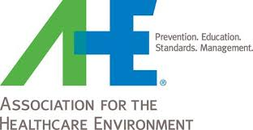
What do the Experts Say About HAIs and Mechanical Cleaning?
Patti Costello, executive director of the Association for the Healthcare Environment. “Understanding how, why and if these new tools and applications may be beneficial to patient outcomes is key. Overall, clearly redefining staff core competencies, aligning them with infection prevention and providing ongoing training and education are the three areas environmental services leaders will be targeting to meet their patient safety goals.

Slide 7
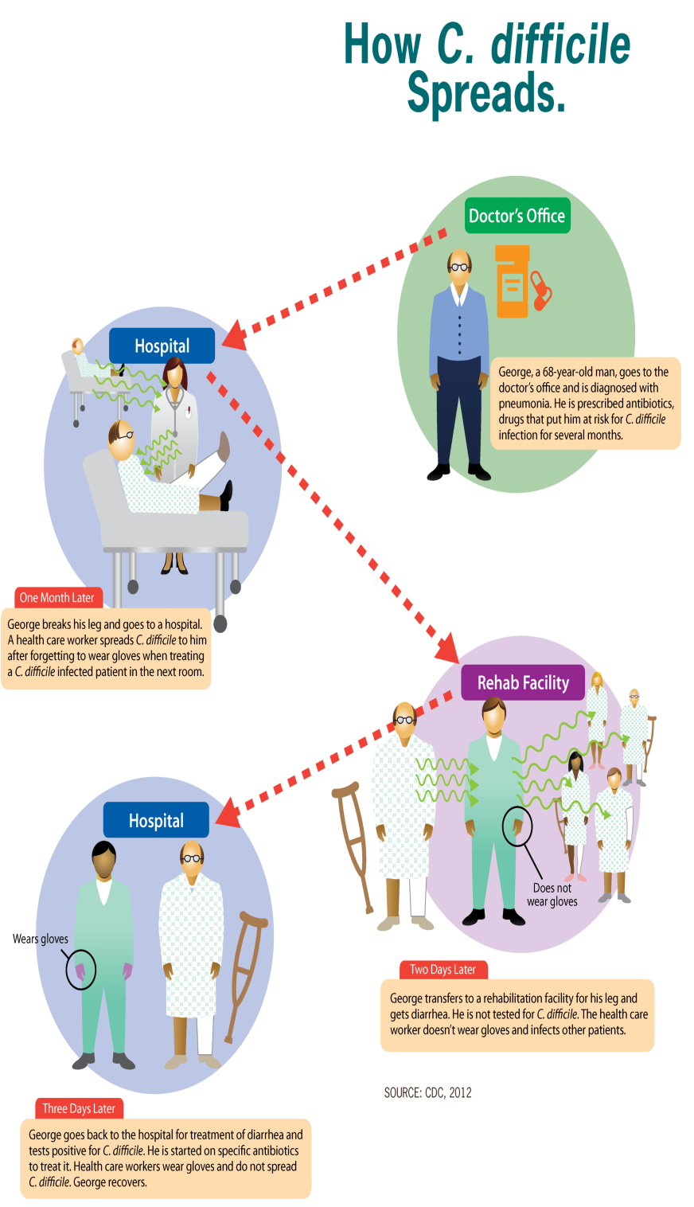
marketing@tomimist.com
Environmental Services Cleaning
A recent study by Sitzlar, et al. (2013) suggested that effective cleaning coupled with staff supervision is a powerful method in decreasing the potential for CDI transmission in hospitals.

Slide 8
So where do we Start?

Slide 9
Perform a gap analysis….
Do our current methodologies fit our needs ?

Slide 10
More Questions….1
Do you have an HAI problem?
Do you have a C. diff problem?
What are the hospital’s goals for HAI reduction?
Does the product work effectively against the standard organisms such as VRE, MRSA, CRE, TB, Pseudomonas, C. diff, fungi/mold, enveloped and non-enveloped viruses?

Slide 11
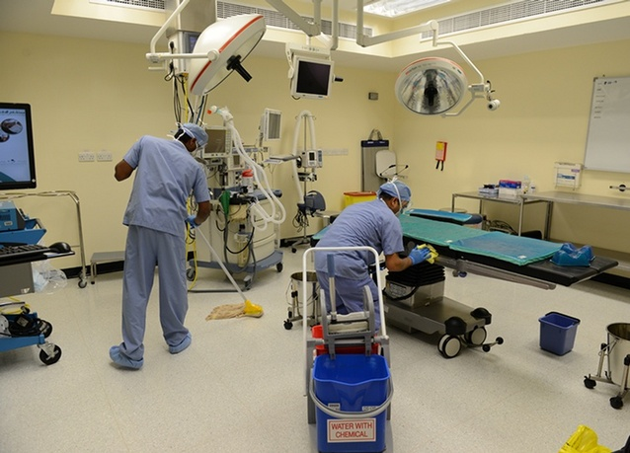
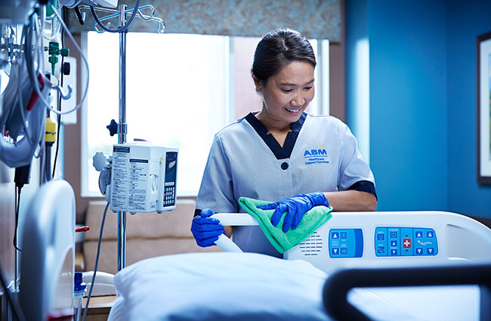
Compliance……Whose Watching?
Is The EVS Staff being compliant with application dilution and contact time?
Are the healthcare workers being compliant with contact time?

Slide 12
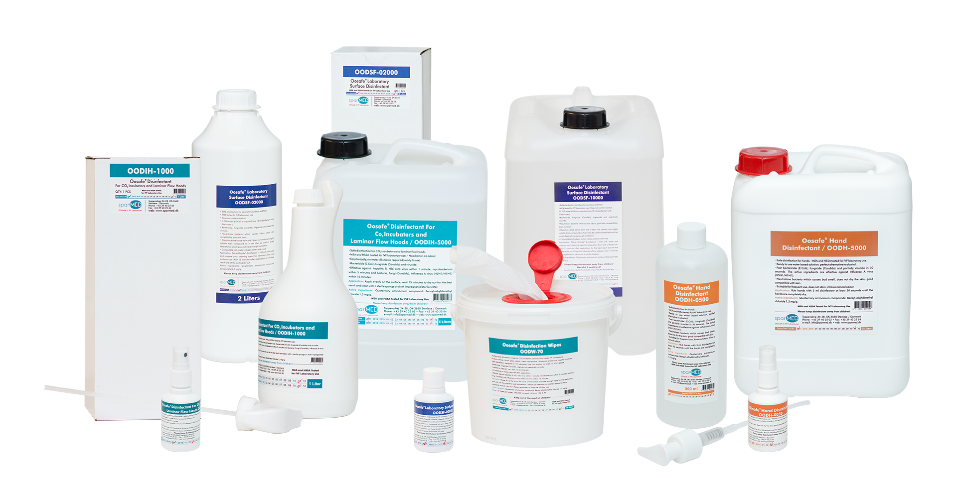
Does your Disinfectant(s)…
Leave a residue?
Is it an oxidizer ?
Does it have a smell?

Slide 13
More Questions…2
Are you using the correct disinfectant for the disinfection task?
How are you monitoring the effectiveness of cleaning?
Which surfaces provide the greatest risk of HAI transmission?
When do use a specific disinfectant: Terminal vs routine, is there a difference?

Slide 14
How do you choose a disinfectant?
Questions to Ask:
What are you currently using?
What agents, in what areas?
Are the agents compatible with each other and with all surfaces?
What are you disinfecting? Hard and soft surfaces?
What interventions are needed?

Slide 15
Disinfectant Classes:
Low level: Vegetative bacteria, fungi, many viruses
Intermediate Level: TB , Vegetative bacteria, fungi, many viruses, some spore claims.
High Level: Medical device and instrument re-processing, regulated by FDA.

Slide 16
marketing@tomimist.com
Microbiological Disinfectant Hierarchy

Slide 17
Examples
Halogens: Bromine, Chlorine, Iodine
Peroxides
Alcohols
Phenolics
Quaternary Ammonium Compounds
UV
Metals: Silver, Copper
High level disinfectants: OPA, glutaraldehyde, Hydrogen peroxide, peracetic acid

Slide 18
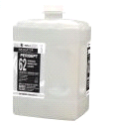
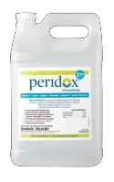
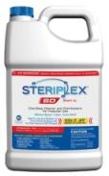
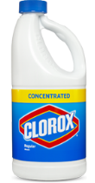
Sporicidal Disinfectants
Sporicidal Disinfectant Cleaners COMPETITIVE ANALYSIS For International Use
Specifications | SteraMist™ BIT™ | PERISEPT | Peridox | OxyCide (Vigorox) | Steriplex | CLOROX (Liquid Chlorine Bleach)
Available Sizes | 1 Gallon (4/case) | 2L (2/case) | 1 Gallon (4/case) 1 Quart (6/case) | 96oz 1/2.5/5 Gallon | 1 gallon (2/case) | 64oz 121oz
Broad Spectrum | 15 Seconds | 2 Minutes | 2 Minutes | 3 Minutes | 5 Minutes | 5 Minutes
Application Data based on | Spray (Mechanical Cleaning) | Wipe (Manual Cleaning) | Wipe (Manual Cleaning) | Wipe (Manual Cleaning) | Wipe (Manual Cleaning) | Wipe (Manual Cleaning)
Product Information (concentrate) | Hydrogen Peroxide less than 8% | Hydrogen Peroxide 7.3% Peroxyacetic Acid 5.9% Sulfuric Acid <1% Other 65.3% | Hydrogen Peroxide 24% Peroxyacetic Acid 1.2% Other 74.8% | Hydrogen Peroxide 27.5% Peroxyacetic Acid 5.8% Acetic Acid 8.0% Other 59.7% | Part A Silver 0.015% Part B Hydrogen Peroxide 22% Peroxyacetic Acid 15% Other 62.99% | Sodium hypochlorite 5.25%
Health Hazard | 0 | 2 | 2 | 1 | 2 | 2
Flammability | 0 | 0 | 0 | 0 | 0 | 0

Slide 20
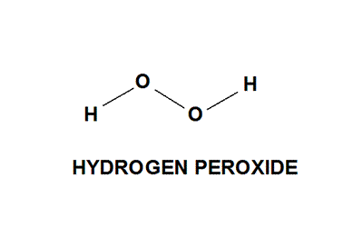
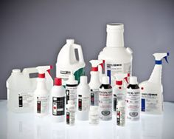
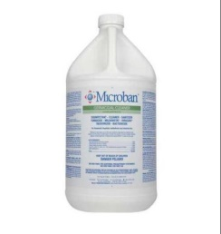
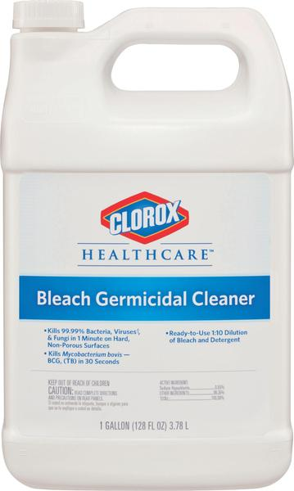
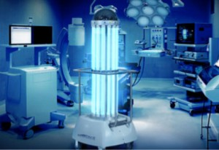
Many combinations leads to confusion….
Hydrogen Peroxide Technologies
Sporicidal Disinfectant Cleaners
Germicidal Disinfectant Cleaners
Ultraviolet Disinfection Systems

Slide 21
Automated Disinfection vs. Manual Cleaning

Slide 22
Manual Methods
Manual cleaning procedures have been documented to leave behind 30%-60% of surface pathogens.
Why?
Does the EVS staff really clean from cleanest to dirtiest?
Do they change their microfiber rags at least three times in patient room?
Are they allowing the disinfectant to be wet for the correct dwell time?

Slide 23
Manual Methods..
How is the cleaning efficacy being monitored: Culture, ATP, Fluorescent markers?
Are the floors cleaned?
Are the drawers cleaned?
Are the curtains removed?

Slide 24
marketing@tomimist.com
Environmental Services Cleaning
High Touch Areas
High touch surfaces are those that have frequent contact with hands. High touch surfaces in care areas require more frequent cleaning and disinfection than minimal contact surfaces. Cleaning and disinfection is usually done at least daily and more frequently if the risk of environmental contamination is higher (e.g., intensive care units).

Slide 25
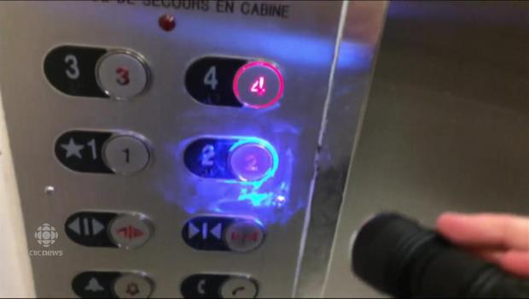
marketing@tomimist.com
Environmental Services Cleaning
Example of Quality Control Guidelines
UV Gel Testing
Each employee will have a minimum of one room checked annually.
If success rate on high touch surfaces is not met, retraining/retesting will occur.
There is a process in place to validate room cleaning compliance.
UV testing is completed following a standard procedure.

Slide 26
Fog/ Mist, electrostatic systems, and UV Systems…Known as no touch Technologies
Automated Methods

Slide 27
Application Modalities
Vapor-fog vs Electrostatic methods:
Is there a difference?

Slide 28
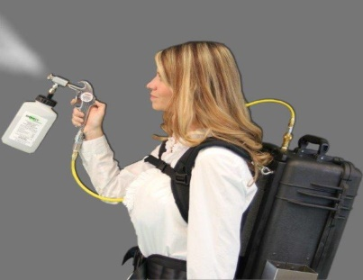
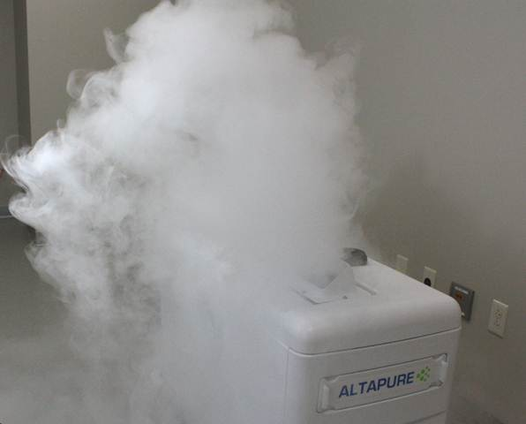
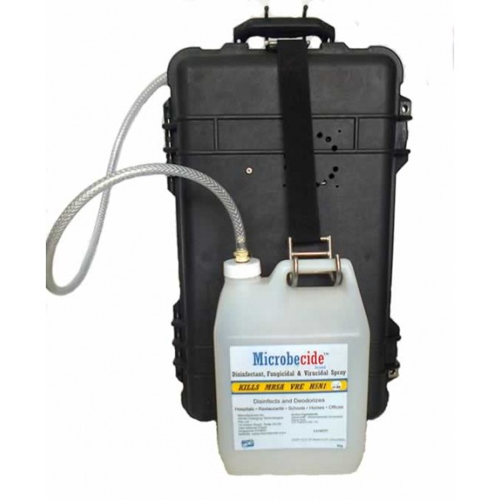
Electrostatic methods examples
AltaPure
Hydrogen Peroxide 22%
Peracetic Acid 4.5 %
Inert Ingredients 73.5%
Biomist
Isopropyl Alcohol
55-65%
Other ingredients
35-45%

Slide 29
Electrostatic methods are not validated as to their delivery….
Liquid being dispersed is validated as a liquid, not as a fog. There is no data supporting the fogging dispersal methods. What is the rate of delivery, what is the effective dwell time, etc. How do we know if there is effective kill?

Slide 30
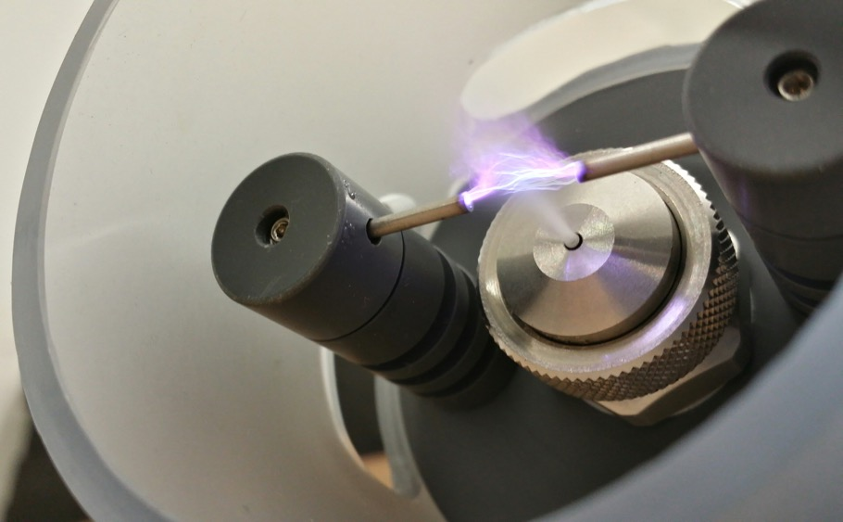
The First EPA Registered Solution + Equipment Combination that Provides the Unique Technology of Hydrogen Peroxide Ionization
H₂O₂ converted by plasma science.
Does not contaminate the environment with any toxic by-products.
Does not leave silver ions on surfaces or equipment.
This product contains the sole active ingredient hydrogen peroxide.
No wipe, no rinse, leaves no residues.

Slide 31
SteraMist™ BIT™ vs. other Hydrogen Peroxide Technologies
Snapshot Comparison:
Steris’s Vaporized Hydrogen Peroxide (VHP) is a high concentration (35%) hydrogen peroxide dry vapor that is highly corrosive, highly dependent on controlled humidity (RH), and not for use as a high-level disinfectant for reprocessing of critical or semi-critical medical devices.
Bioquell’s Hydrogen Peroxide Vapor (HPV) is also a high concentration H202 (30%), is considered HAZMAT, and due to lengthy treatment times, is highly corrosive on metals and other materials.
Sanosil’s Activate Hydrogen Peroxide (aHP) is a hydrogen peroxide and Silver anion solution that can cause buildup or residue with multiple uses and has limited room treatment/application parameters.

Slide 32
The SteraMist Competitive Advantage
 | *7.8% H₂O₂ | *30% H₂O₂ | *5% H₂O₂ & Silver | *35% H₂O₂
 | Non Corrosive Converts to Oxygen, and Water (humidity) | Highly Corrosive Dangerous off-gassing | Moderately Corrosive however Leaves Silver Cations in the environment, Oxygen, and Water | Highly Corrosive Dangerous off-gassing
*Ingredients taken from EPA label

Slide 33
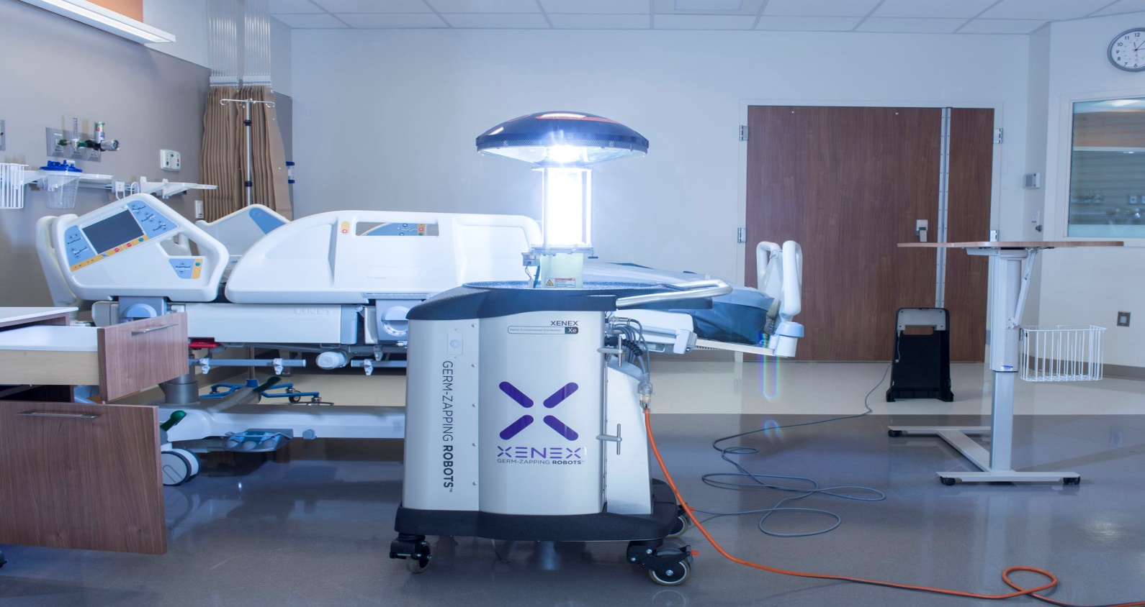
UV Systems

Slide 34
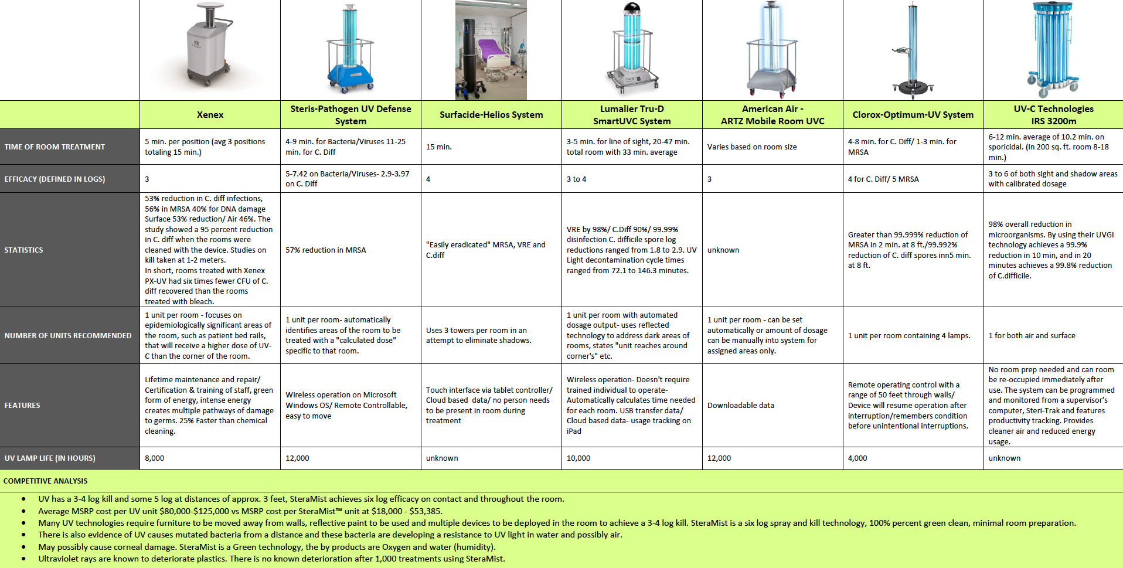
Ultraviolet Disinfection Systems

Slide 35
COMPETITIVE ANALYSIS UV vs SteraMist
UV has a 3-4 log kill and some 5 log at distances of approx. 3 feet, SteraMist achieves six log efficacy on contact and throughout the room. Average MSRP cost per UV unit $80,000-$125,000 vs MSRP cost per SteraMist™ unit at $18,000 - $53,385. Many UV technologies require furniture to be moved away from walls, reflective paint to be used and multiple devices to be deployed in the room to achieve a 3-4 log kill. SteraMist is a six log spray and kill technology, 100% percent green clean, minimal room preparation.

Slide 36
There is also evidence of UV causes mutated bacteria from a distance and these bacteria are developing a resistance to UV light in water and possibly air.
May possibly cause corneal damage. SteraMist is a Green technology, the by products are Oxygen and water (humidity).
Ultraviolet rays are known to deteriorate plastics. There is no known deterioration after 1,000 treatments using SteraMist.

Slide 37
Comparison of Peroxide vs UV
peroxide
Peroxide based technologies are microbicidal against a wide number of pathogens.
Have a uniform distribution in a room via automated dispersal systems.
Equipment does not need to be moved.
Can withstand some protein contamination.
Depending on concentration of peroxide rooms may need to be sealed.
UV
Room must be vacated and disinfected (terminal clean).
Furniture must be moved away from walls to prevent shadowing.
Long room turn-around time for kill.
Direct line of sight necessary.
Relative Log kill effectiveness is not validated by EPA

Slide 38
SteraMist™ BIT™ vs. UV Systems
Snapshot Comparison:
SteraMist’s AIHP goes everywhere – up, in, and around. UV is direct line of sight, like a light bulb.
SteraMist carries the same concentrated ROS throughout the room, UV loses strength the further from the light bulb.
Shadows from furniture and equipment cause major issues. To combat this, operators will use reflective paint, multiple lights, or move equipment around to reduce the chance of missing an area. This requires an extra investment of time, personnel, and effort, but also of money – UV systems can be quite expensive.

Slide 39
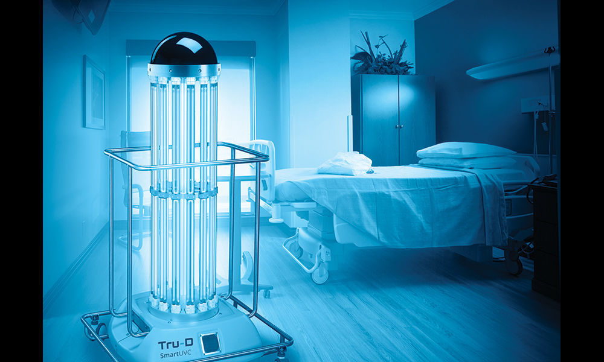
How does SteraMist™ compare to UV-c systems
SteraMist™ BIT™ is EPA registered for use as a Healthcare-Hospital Disinfectant (EPA Reg. No. 90150-2). Not all UV-c systems are.
The properties and effectiveness of the system are validated with EPA methods for proven efficacy and performance. The UV-c systems are not.
Performance claims are validated and specified in the labelling from EPA, the UV-c systems are not.
The efficacy of the UV-c systems in the published literature is quite variable and not consistent from user to user. UV-c systems vary in their delivery of UV rays.

Slide 40
Driving and Measuring the Interventions.
How do costs factor in?
Where is the Proof of efficacy?

Slide 41
What do the Studies Say?

Slide 42
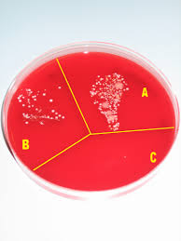
The Six-Log Advantage
Household/Industrial Cleaners
3-Log 99.9% to 4-log kill 99.99% of pathogens | 6-Log kill 99.9999% on all challenged Pathogens including the Geobacillus stearothermophilus spore
Dwell time ranges from 5 to 30 minutes | Kills within seconds of application
99.9%
99.99%
99.9999%

Slide 43
Efficacy Against Microbial Pathogens
EPA Accepted GLP Studies | Internationally Accepted GLP Studies

Slide 44
Process of getting EPA Registered is a difficult, time consuming, and expensive process.
Find an accredited lab
Receive an EPA approved Protocol
Run R&D Tests
Run GLP Tests
Pass GLP Tests
Receive Final Report
Submit revised registration and final GLP report studies to the EPA
Discuss, review, and edit revised registration with the EPA
Wait 90 days for review

Slide 45
All Hospital Disinfectants must be EPA Registered
All disinfectants and pesticides marketed for use in United States must meet safety requirements as described in OCSPP 810.2200, (1) Applicability. This guideline describes test methods that EPA believes will generally satisfy testing requirements of the Federal Insecticide, Fungicide, and Rodenticide Act (FIFRA) (7 U.S.C. 136, et seq.) and the Federal Food, Drug, and Cosmetic Act (FFDCA) (21 U.S.C. 346a). It addresses testing to demonstrate the effectiveness of antimicrobial pesticides bearing claims as disinfectants, fungicides, virucides, and tuberculocides. (EPA 712-C-07-074)

Slide 46
marketing@tomimist.com
List K: EPA Registered Antimicrobial Products Effective Against C. diff Spores
No. | Primary Registered Product Name
777-83 | LYSOL BRAND DISINFECTANT BLEACH PLUS
1043-124 | HASTE-SSD-COMPONENT B
1043-125 | HASTE-SSD-COMPONENT A
1672-65 | AUSTIN A-1 ULTRA DISINFECTING BLEACH
1672-67 | AUSTIN’S A-1 CONCENTRATED BLEACH 8.25%
1677-226 | VIRASEPT
1677-235 | BATH AND TILE DISINFECTING CLEANER
1677-237 | FF-ATH
3573-77 | CSP-3002-3
5813-100 | PUMA
9402-13 | KIMTECH GERMICIDAL WIPE
9480-8 | PDI SANI-CLOTH BLEACH WIPES
10324-214 | MAGUARD 5626
11346-3 | CLOROX HW
56392-7 | DISPATCH HOSPITAL CLEANER DISINFECTANT WITH BLEACH
56392-8 | DISPATCH HOSPITAL CLEANER DISINFECTANT TOWELS WITH BLEACH
67619-8 | CPPC ULTRA BLEACH 2
67619-12 | CPPC TSUNAMI
67619-27 | BUSTER
69687-1 | SUPER-CHLOR

Slide 47
Efficacy Against Microbial Pathogens
EPA Registered Good Laboratory Practice Study Summaries for SteraMist Bit Solution
Study Title: Efficacy of a Disinfectant Applied to a Room via a Fogging, Misting, or Vaporizing Device for Disinfection of C. difficile spores
Study Title: AOAC Germicidal Spray Method -­‐ Methicillin Resistant Staphylococcus aureus -­ MRSA
Study Title: Virucidal Efficacy of a Disinfectant for Use on Inanimate Environmental Surfaces - Influenza A (H1N1) Virus
Study Title: AOAC Germicidal Spray Method – Staphylococcus aureus (Staphylococcus) (Staph), Pseudomonas aeruginosa (Pseudomonas)
Study Title: Efficacy of a Disinfectant Applied to a Room via a Fogging, Misting, or Vaporizing Device for Disinfection – Staphylococcus aureus (Staphylococcus) (Staph), Pseudomonas aeruginosa (Pseudomonas)

Slide 48
What about UV-c ?
Most UV units are not EPA registered.
Efficacy is dependent on End-user data
Controlled studies are difficult to find.
No an even playing field whencomparing killing efficacy or log kill achieved.

Slide 49
Summary of Published HAI Reduction Studies Associated with Pulsed Xenon Ultraviolet Disinfection Systems Stibich, M. (2016, May 13). Reduction of HAIs through the use of pulsed Xenon UV disinfection. Retrieved from http://infectioncontrol.tips/2016/05/13/reduction-hai-pulsed-xenon
Study Site | Organism of Interest | Healthcare Setting | Incidence Reduction | Estimated Impact
Lowell General Hospital [8] | Class I Surgical site infections | Operating Room | 46% | 23 fewer cases in 10,883 procedures
Trinity Medical Center [9] | Total Hip/Knee SSIs (Class I) | Operating Room | 100% | 7 fewer cases in 544 procedures
Westchester Medical Center [10] | Multiple MDROs | Acute Care | 20% | 185 fewer cases in 22 months
Cooley Dickinson Hospital [11] | C. difficile | Acute Care | 53% | 17 fewer cases in 12 months
LTAC Facility [12] | C. difficile | LTAC | 57% | 29 fewer cases in 15 months
Westchester Medical Center [13] | C. difficile | ICU | 70% | 30 fewer cases in 12 months
Cone Healthcare System [14] | MRSA | Healthcare System | 56% | 58 fewer cases in 18 months
Orlando Health South Seminole Hospital [15] | Multiple MDROs; C. difficile | Acute Care | 61% | 39 fewer cases in 22 months

Slide 50
Other Factors to consider

